Slide 1
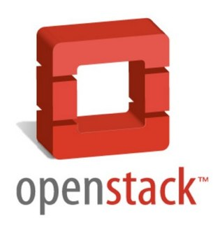

OpenStack Analysis and comparison of cloud platforms
Openstack 云平台分析与比较
班级: 电信09
学生姓名：卡那那
学号： 60902060
指导教师: 郝卫东

Slide 2
Table of Contents
Cloud computing
What is OpenStack?
Code names Components
OpenStack 云平台与其它云平台进行比较研究
Conclusion

Slide 3
Cloud computing
Cloud computing is the use of computing resources (hardware and software) that are delivered as a service over a network (typically the Internet), where resources such as computing power, storage, network and software are abstracted and provided as services on the Internet.
The following are the broad categories of services available on the cloud: Infrastructure as a Service (IaaS), Platform as a Service (PaaS), Software as a Service (SaaS), and Network as a service (NaaS).

Slide 4
What is OpenStack?
OpenStack is a United States National Aeronautics and Space Administration and Rackspace cloud computing software R & D cooperation, Apache license authorization, and is a free software and open source projects.
OpenStack is IaaS (Infrastructure as a Service) software; anyone can create their own cloud computing services

Slide 5
Cont.
OpenStack is a cloud operating system that controls large pools of compute, storage, and networking resources throughout a datacenter, all managed through a dashboard that gives administrators control while empowering their users to provide resources through a web interface.

Slide 6
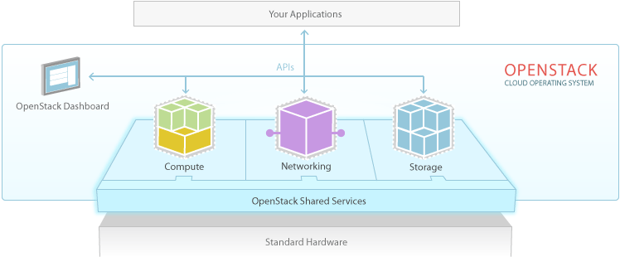
OpenStack Diagram

Slide 7
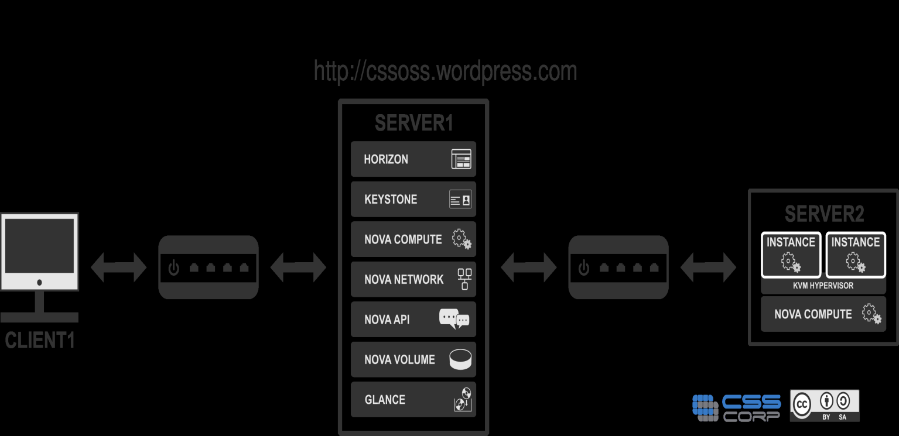
OpenStack Setup
Figure 2- OpenStack Setup
Server1, Server2 and Client1

Slide 8
Code names Components
OpenStack has a modular architecture that encompasses following components:
Nova (Compute Service)
Swift (Storage Service)
Glance (Imaging Service)
Keystone (Identity Service)
Horizon (UI Service)

Slide 9
Compute Infrastructure (Nova)
Nova is a cloud computing fabric controller (the main part of an IaaS system).
Functions and Features: Instance life cycle management, management of compute resources, networking and authorization, REST-based API.
Components of Nova: API Server, message queue,compute workers, network controller,volume worker, scheduler.

Slide 10
Storage Infrastructure (Swift)
Swift is a massively scalable redundant storage system. Objects and files are written to multiple disk drives spread throughout servers in the data center, with the OpenStack software responsible for ensuring data replication and integrity across the cluster.
Functions and Features: storage of large number of objects and sized objects, secure storage of objects, backup and archival.
Components of Swift: swift Account, swift container, swift Object, swift Proxy and the RING.

Slide 11
Imaging Service (Glance)
Glance provides discovery, registration and delivery services for disk and server images. It provides a catalog and repository for virtual disk images.
Functions and Features: provides imaging service.
Components of Glance: glance-control, glance-registry.

Slide 12
Identity Service (Keystone)
Keystone provides a central directory of users mapped to the OpenStack services they can access. It provides authentication and authorization for all components of OpenStack including Swift, Glance, Nova.
Keystone provides services : token service, catalog Service and policy Service.
Components of Keystone: endpoints, regions, user, services, role, tenant.

Slide 13
Administrative Web-Interface (Horizon)
Horizon provides administrators and users a graphical interface to access, provide and automate cloud-based resources. Horizon the web based dashboard can be used to manage /administer OpenStack services.
Functions and Features: Instance, image, volume management ; access and security management; object store manipulation.

Slide 14
OpenStack 云平台与其它云平台进行比较研究
General information
Supported hosts
Supported Clients
Providers
Features

Slide 15
1. General information

Slide 16
Software | Initial release date | License (s) | Written in | As a service | Local installations
Fluid Operations | 2009-03-01 | Proprietary | Java, C | Yes | ?
AppScale | 2009-03-07 | BSD License | Python, Ruby, Go | Yes | Yes
Cloud Foundry | 2011-04-12 | Apache License | Ruby, C | Yes | Yes
Cloud.com | 2010-05-04 | Apache License | Java, C | Yes | Yes
Eucalyptus | 2008-05-29 | Proprietary GPL v3 | Java, C | Yes | Yes
Flexiant Limited | 2007-01-15 | Proprietary software | Java, C | Yes | Yes
Nimbus | 2009-01-09 | Apache License | Java, Python | Yes | Yes
OpenNebula | 2008-03 | Apache License | C++, C, Ruby, Java, Shell script, lex, yacc | Yes | Yes
OpenQRM | 2008-03 | GPL License | C++, PHP, Shell script | Yes | Yes
OpenShift | 211-05-04 | Apache License | Ruby | Yes | Yes
OpenStack | 2010-10-21 | Apache License | Python | Yes | Yes
OnApp | 2010-07-01 | Proprietary | Java, Ruby, C++ | Yes | Yes
OVirt | 2012-08-09 | Apache License | Java, Python | ? | Yes

Slide 17
2. Supported hosts

Slide 18
Software | Linux | Windows | Bare Metal
Fluid Operations | Yes | Yes | No
AppScale | ? | ? | ?
Cloud Foundry | Yes | No | No
Cloud.com | Yes | ? | Yes
Eucalyptus | Yes | ? | Yes
Flexiant Limited | No | Yes | Yes
Nimbus | ? | ? | ?
OpenNebula | Yes | ? | No
OpenQRM | Yes | No | No
OpenShift | Yes | No | Yes
OpenStack | Yes | Yes | No
OnApp | Yes | No | Yes
OVirt | Yes | No | No

Slide 19
3. Supported Clients

Slide 20
Software | Linux | Windows | VMware | Xen | KVM | VirtualBox | Other
Fluid Operations | Yes | Yes | Yes | Yes | Yes | No
AppScale | ? | ? | Yes | Yes | Yes | Yes
Cloud Foundry | Yes | No | Yes | Yes | Yes | Yes
Cloud.com | Yes | ? | Yes | Yes | Yes | Yes
Eucalyptus | ? | ? | Yes | Yes | Yes | ?
Flexiant Limited | Yes | Yes | Yes | Yes | Yes | Yes | FreeBSD
Nimbus | ? | ? | ? | Yes | Yes | ?
OpenNebula | Yes | Yes | Yes | Yes | Yes | Yes | Any guest OS supported by Xen, KVM, or VMWare
OpenQRM | Yes | Yes | Yes | Yes | Yes | Yes
OpenShift | Yes | No | Yes | Yes | Yes | Yes
OpenStack | Yes | Yes | Yes | Yes | Yes | ?
OnApp | Yes | Yes | Yes | Yes | Yes | No | JumpBox, FreeBSD

Slide 21
4. Providers

Slide 22
Software | Amazon EC2 | Rackspace | GeoGrid | Other
Fluid Operations | ? | ? | ?
AppScale | Yes | ? | ?
Cloud Foundry | Yes | ? | ?
Cloud.com | ? | ? | ? | Itself
Eucalyptus | ? | ? | ? | Itself
Flexiant Limited | ? | ? | ? | Itself
Nimbus | ? | ? | ? | Itself
OpenNebula | ? | ? | ? | Itself
OpenQRM | ? | ? | ? | Itself
OpenShift | Yes | ? | ?
OpenStack | Yes | Yes | Yes
OnApp | ? | ? | ? | Itself

Slide 23
5. Features

Slide 24
Software | Failover | OCCI | vCloud | S3 | Failover
Fluid Operations | No | No | Yes | No | No
AppScale | No | ? | ? | Yes | No
Cloud Foundry | No | No | Yes | No | No
Cloud.com | Partial | ? | ? | ? | Partial
Eucalyptus | No | ? | ? | Yes | No
Flexiant Limited | Yes | No | Yes | No | Yes
Nimbus | No | ? | ? | ? | No
OpenNebula | No | Yes | Yes | No | No
OpenQRM | Yes | Yes | ? | ? | Yes
OpenShift | No | No | No | No | No
OpenStack | No | Yes | ? | Yes | No
OnApp | Yes | No | No | No | Yes

Slide 25
Conclusion
OpenStack is architected to provide flexibility as you design your cloud, with no proprietary hardware or software requirements and the ability to integrate with legacy systems and third party technologies.
One of the really exciting things about OpenStack is how quickly it has become an international project and how it is rapidly becoming the factor open source standard for cloud computing. Because OpenStack is open source software, other companies can pursue similar opportunities.

Slide 26
Cont.
OpenStack is an early project and has not matured into a production product but it is fully open source and based on open cloud standards.
An open private production cloud using OpenStack with open cloud standards will probably be production ready in 2014 when Ubuntu 14.04 is released and when other internet broadband providers come online.

Slide 27
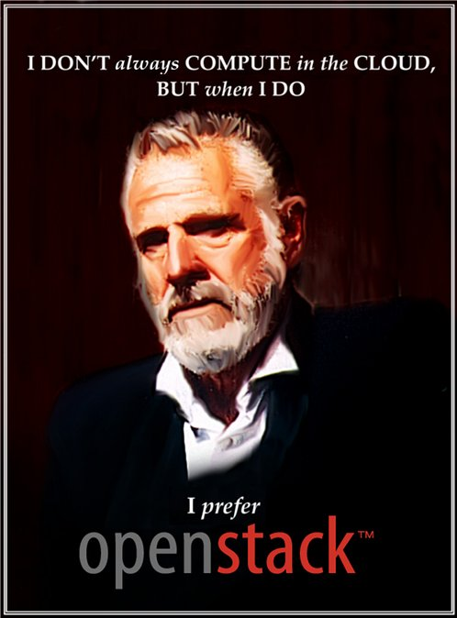
Thank You, 谢谢你们

